Slide 1
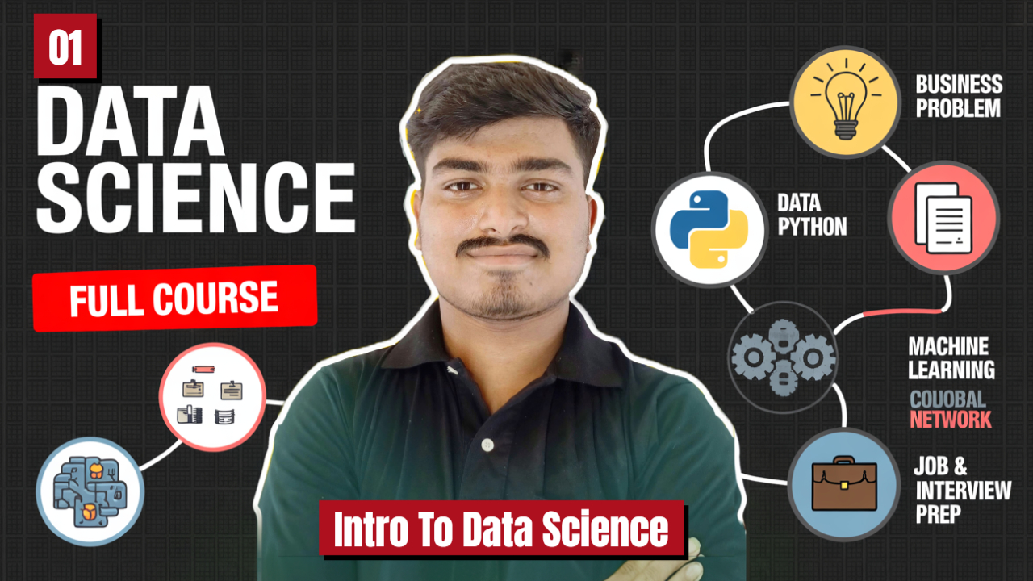

Slide 2


Data Science
- Sushant Sharma
1

Slide 3

Introduction to Data Science
Data science is the art and science of transforming raw data into meaningful insights and actionable decisions using a blend of statistics, computer science, and domain expertise. It’s like being a detective who uses numbers, code, and real-world knowledge to solve puzzles and make the world smarter, more efficient, and better connected.

Slide 4

Three Pillars of Data Science
Domain Knowledge
Computer Science
statics
The skills to collect, process, and analyze massive amounts of data efficiently.
The tools to uncover patterns and truths in data.
The real-world context (like business, healthcare, or sports) that gives data meaning.

Slide 5

Applications Across Industries
Healthcare: Developing personalized treatment plans and improving drug discovery by analyzing patient data.
Finance: Conducting risk assessments, detecting fraudulent activities, and enabling algorithmic trading.
Retail: Enhancing customer experiences through personalized product recommendations and optimizing inventory management.
Transportation: Designing autonomous vehicles and optimizing delivery routes for logistics companies.
Entertainment: Powering recommendation engines for streaming services by analyzing user preferences.

Slide 6

Real Life Application
Social Media Recommendation
E-Commerce Recommendations
Image Recognition
Prediction Systems

Slide 7
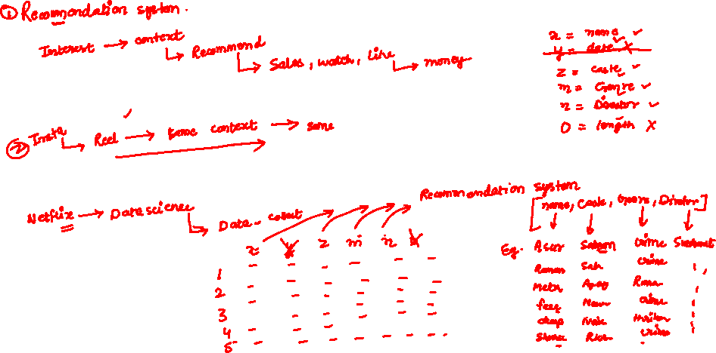
Real Life Example

Slide 8


Slide 9

JOBS and Career in Data Science
Data Scientist
Data Engineer
ML Engineer
Data Analyst
Business Intelligence Analyst

Slide 10
